Slide 1
Best Practices Developing Service Learning Protocol for Hospitality Administration
Mary S. Olle, Ph.D., Chay R. Runnels, Ph.D., Gina Fe G. Causin, Ph.D., and Todd Barrios, CEC
Hospitality Administration, School of Human Sciences, Stephen F. Austin State University
ollemary@sfasu.edu
936-468-1873

Slide 2
Problem
Students in the SFASU Hospitality Administration Program need to recognize the value of community relations in the hospitality industry.
Developing Service Learning Protocol for students in Hospitality Administration provides an opportunity for students to experience these values such as networking, commitment, and building self-confidence.
In 2015 SFA Hospitality Administration faculty made a decision to institutionalize service learning throughout their program.
An online volunteer website (SignUp Genius) was utilized to manage the signup process.

Slide 3
Case Study
The Hospitality Administration program at Stephen F. Austin State University has enjoyed a mutually beneficial relationship with many community and campus organizations.
Service learning opportunities in the hospitality industry are particularly important for students seeking to work in the hospitality industry (O’Halloran and O’Halloran, 1999).
Numerous studies have recommended that there is a need for hospitality and tourism educators to plan their teaching and learning activities so that student learning preferences are recognized and the gap between educational practice and student learning is minimized (Barron & Arcodia, 2002; Lashely, 1999; Lashley & Barron, 2006, Lashley & Shaw, 2002; Stevens, Kitterlin, & Tanner, 2012).

Slide 4
discussion
Protocol Procedures
Students enrolled in face to face hospitality courses were required to complete 6 hours of service learning which was embedded in course curriculum.
50 points were attached to the assignments with no partial credit offered.
Community event opportunities were posted on the homepage of each face to face course with a link to the SignUp Genius page.
Students were asked to provide documentation of the events they worked, the hours, and a signature of the contact person for verification purposes.

Slide 5
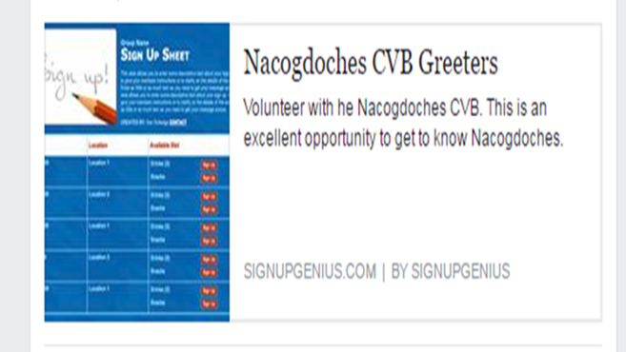
discussion
Protocol Procedures
Students were asked to provide documentation of the events they worked, the hours, and a signature of the contact person for verification purposes.
A due date was established stating when the service learning hours needed to be completed within the semester.

Slide 6
discussion
Challenges Faced in Developing Service Learning Protocol
Faculty continue to face challenges including no-shows, students switching signups or deleting signups prior to the service learning event, and other issues there were unforeseen.
Site supervisors may not be familiar with the online signup platform and have difficulty understanding that some events may not have any volunteers due to self-selection and signup. Some volunteers wanted to participate in the service learning component however they wanted to use their own signup platform.
Further issues included students wanting to count non-approved, non-vetted events, or events they were working not related to hospitality.
The need for a standardized log sheet was also realized for consistency in reporting service hours as well as for submission to receive credit.

Slide 7
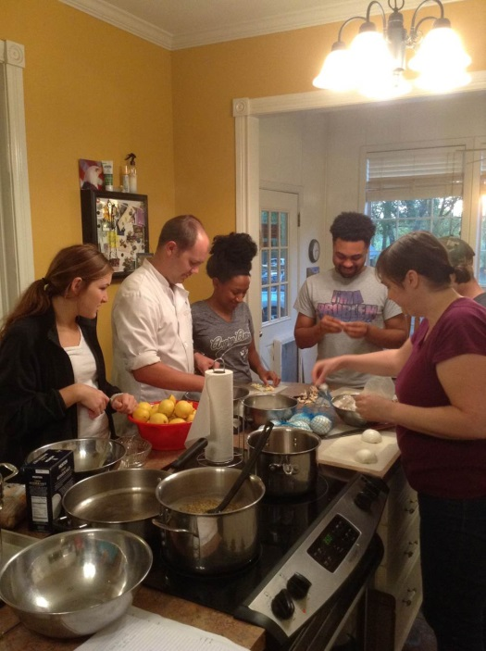
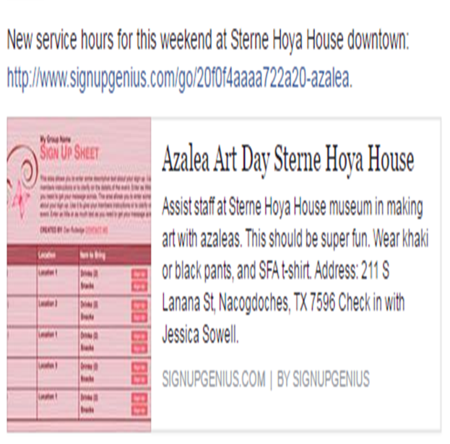
Student Evaluation results
Evaluating Student Engagement
More than 130 students participated in this project and generated 786 volunteer hours.
Analysis indicated that 76% or majority of the respondents strongly agree that the service learning assignment benefited them personally.

Slide 8
Student Evaluation results
Evaluating Student Engagement
Service learning assignment enhance program visibility. Half (50%) of the students agreed or strongly agreed the service learning assignment enhanced the programs visibility.
Service learning assignment beneficial to student’s career goals. In response to the question whether the service learning opportunities where beneficial to the student’s career goals, just over half (60%) stated they strongly agreed or agreed the required service hours were of benefit.
Service learning assignment increased student’s awareness of the community. Respondents were asked if the required service learning assignment increased their awareness of community events. Seventy-nine percent agreed or strongly agreed they were more aware of community events.

Slide 9
References
Barron, P. and Arcodia, C. (2002). Linking learning style preferences and ethnicity:
International students studying hospitality and tourism management in Australia. Journal of Hospitality, Leisure, Sport and Tourism Education, 1(2), 1-13.
Lashley, C. (1999). On making silk purses: Developing reflective practitioners in
hospitality management education. International Journal of Contemporary Hospitality Management, 11(4), 180-185.
Lashley, C. & Barron, P. (2006). The learning style preferences of hospitality and
tourism students: Observations from an international and cross-cultural study. International Journal of Hospitality Management, 25(4), 552-569.
Lashley, C. & Shaw, M. (2002). The effects of learning styles on student achievement
in HE and the implications for curriculum design, development, and delivery. European Learning Styles Information Network Conference Proceedings. Ghent, Belgium: University of Ghent.
Stevens, D. P., Kitterlin, M. and Tanner, J. R. (2012). Assessing the impact of learning
styles for hospitality students. Consotium Journal of Hospitality and Tourism, 17, 6-28.
O’Halloran, R. M & C. S. O’Halloran (1999) Service learning in the hospitality and
tourism business environment. Journal of Hospitality and Tourism Education. 10:4.

