Slide 1
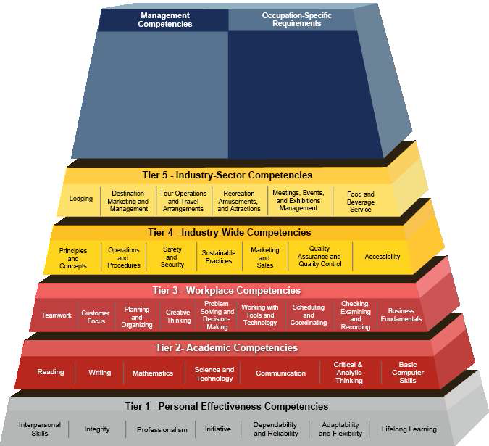
Tourism Job Outlook: A Guide to Events, Hospitality, Interpretation Jobs for the Lakota People
Introduction
Expo!
Expo!
Introduction
Gina Fe G. Causin, Ph.D. and Chay Runnels, Ph.D.
Stephen F. Austin State University, Nacogdoches, Texas
References
The travel and tourism industry is one of the largest industries in the United States, making a total contribution of 1.42 trillion U.S. dollars to GDP (Statista, 2014) which supports 15 million jobs in the U.S. which is an 8 million direct tourism jobs and 7 million indirect and induced jobs. Twenty-seven thousand four hundred seventy-seven (27,477) jobs directly supported by core tourism in South Dakota and 6.5% of total South Dakota employment. According to the report, “Core Tourism generated $1.36 billion in economic value in 2014,” thus ranking core tourism in the top 10 of private industry in terms of Gross State Product (Norton, 2015).
The 2013 Visitor Intercept Survey found that Rapid City, SD was the number one in-state destination for travelers among the in-target group with Black Hills Badlands & Lakes Region as the second most popular destination. Tourists want to visit national parks and monuments as well as historic and cultural sites connected to tribal culture. The emphasis on tourism in the economy of South Dakota provides extensive opportunities in the field of Hospitality and Tourism for employment in the region. Specific employment opportunities exist in the hotel, food and beverage, and travel accommodation industries.
The average yearly salary provided by the tourism and hospitality industry amongst these positions is $55,415 with a range between $45,810 and $81,080. These numbers are significantly higher than the national average quoted by the Bureau of Labor Statistics (BLS) of all employment positions. It is obvious that employers within the industry are looking for applicants who possess number of skills and competencies (check figure 1) that can be developed in conjunction with their bachelor’s degrees.
A well-developed tourism and hospitality program will encourage the development of these skills through in class participation, assignments which refine these skills, and a major end of semester project that incorporates these skills and competencies in a presentation format. Stakeholders in the Pennington County (Rapid City, Wall and Keystone area) were interviewed in August 2015 about their willingness to hire interns or seasonal workers connected to Oglala Lakota College.
Bureau of Labor Statistics, U.S. Department of Labor (2015) Occupational Outlook Handbook, 2016-17 Edition, Meeting, Convention, and Event Planners . Retrieved on December 1, 2015 from http://www.bls.gov/ooh/business-and-financial/meeting-convention-and-event-planners.htm
Norton, S. (2015) 2014 Tourism Satellite Account Report. Pierre, SD: South Dakota Department of Tourism.
Select USA. (2015). The Travel, Tourism and Hospitality Industry in the United States. Retrieved on October 20, 2015 from http://selectusa.commerce.gov/industry-snapshots/travel-tourism-and-hospitality-industry-united-states.html
Statista. (2014). US Travel Association Talking Points and Travel Facts. Retrieved on October 20, 2015 from https://www.ustravel.org/marketing/national-travel-and-tourism-week/talking-points-and-facts
South Dakota Department of Tourism. (2015). South Dakota Department of Tourism Annual Report 2014. Pierre, SD
South Dakota Department of Tourism. (2013). Information Center Annual Intercept Report Summer 2013. Pierre, SD.
South Dakota Department of Tourism. (2013) 2012 Omnibus Survey-Vacation Interests Results. Sioux Falls, SD: Lawrence and Schiller Advertising and Marketing.
Competencies of Tourism and Hospitality Workers
Job Opportunities for the Lakota People
The emphasis on tourism in the economy of South Dakota provides extensive opportunities in the field of Hospitality and Tourism for employment in the region. Specific employment opportunities exist in the hotel, food and beverage, and travel accommodation industries. Local job postings indicate opportunities for Lodging Managers, Meeting, Convention, and Event Planners, Food Service Managers, and Administrative Service Managers. On a national level, these positions all show expected growth of between 2-33% over the next seven years (Bureau of Labor Statistics Occupational Handbook, 2015).
This project was funded by the National Park Service

