Slide 1
By Dr. Jim Ewing SFA Diversity Conference 2/12/21
Math for Emergent Bilinguals. As Easy as Uno, Dos, Tres.
www.EwingLearning.com

Slide 2
Welcome
What do you
appreciate today?
What do you
already know
about meeting the
needs of EBs in math?

Slide 3
Guide
Let me be your GUIDE for the next 30 minutes.
You can be a GUIDE for your EBs.

Slide 4
Pen and Paper
Pen and paper great for notes
Email me for slides at Ewingjs@sfasu.edu

Slide 5
Storytelling

Slide 6
Words Matter
“ELs, ELLs”: deficit
“EBs”: values both languages
NCSM Position Paper: Multilingual Learners

Slide 7
Ewing, J. (2017). Facilitating pre-service teachers to learn the Mathematical Practices and engage English language learners. The Journal of Multicultural Affairs, 2(1), 1-5.
Resuelve los Problemas

Slide 8
Las Matemáticas
How did you feel when I taught you in Spanish?
How could I have taught you better?

Slide 9
3 Tools
Are universal
Work in classroom, online & home

Slide 10
Class & Distance Learning
Positive Math Mindset
Provide Access
Teach Language

Slide 11
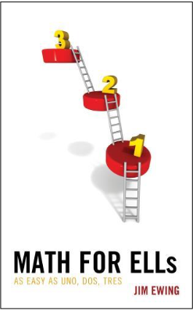
Tool #1
Would you like school if it was taught like this?
We need to develop our students’ positive math mindsets.
Ewing, 2020

Slide 12
1. Positive Mindset
Celebrate EBs’ culture.
Play music from EBs’ culture.
Use math problems that EBs can relate to.
Ewing, J. (2017). Facilitating pre-service teachers to learn the Mathematical Practices and engage English language learners. The Journal of Multicultural Affairs, 2, 1-5.

Slide 13
1. Positive Mindset
Choose problems your students can relate to…
Who has more frijoles?
Activities written by the Math/ELL Gurus from Teachers Pay Teachers

Slide 14
Effect Size 1.51?
What promotes a positive math mindset and has an effect size of 1.51?

Slide 15
Energy Management
Reduce stress= stretch, slow breathing
Energize= move to music, calisthenics
EFFECT SIZE = 1.51!
Erwin,H, Fedewa,A, Beighle, A&Ahn,S.(2012): A quantitative Review of Physical Activity, Health ,and
Learning Outcomes Associated With Classroom-Based Physical Activity Interventions, Journal of Applied School Psych., 28, 14-36 & Dweck, C. S. (1999) Self Theories: Their Role in Motivation, Personality, and Dev.

Slide 16
Brain Break

Slide 17
Monstrous Opportunity!
Free Resources
at
EwingLearning.com

Slide 18
Reflection
What is your take-away so far?
Feel free to share in the Chat

Slide 19
Tool #2
Were you able to solve the problems?
We need to provide our students access
Ewing, J. (2018). Considering ELLs when planning lessons. Ohio Journal of School Mathematics, 78 (1), 52-56

Slide 20
Ewing (2017). Facilitating pre-service teachers to learn the Mathematical Practices and engage English language learners. The Journal of Multicultural Affairs, 2(1), 1-5.
What was I Asking?

Slide 21
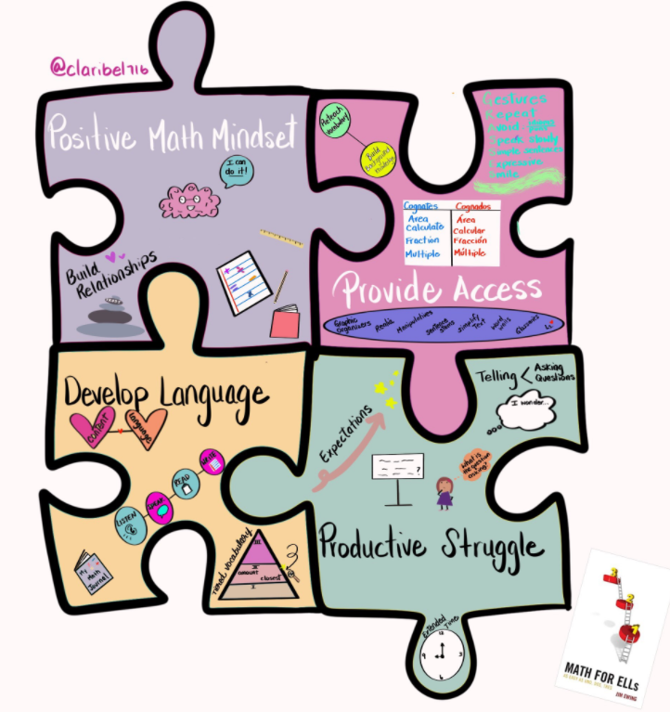
2. Provide Access
Visuals not enough!! Visualize
Authentic graphic organizers; sentence stems

Slide 22
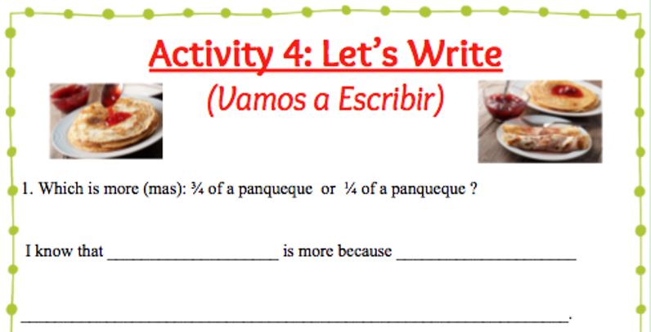
2. Provide Access
Use sentence frames and own language
Activities written by Math Distance Learning for ELLs from Teachers Pay Teachers

Slide 23
Tool #3
Did I teach you Spanish?
We need to teach
our students’ language.
Lucas, T. (2011). Language, schooling, and the preparation of teachers for linguistic diversity. In T. Lucas (Ed.), Teacher preparation for linguistically diverse classrooms: A resource for teacher educators (pp. 3-17)

Slide 24
3. Teach Language
Let students speak more
Read book at beginning of lesson
Model Spanglish

Slide 25
Develop Your Language?
What is a common practice that is NOT good for developing EBs’ language?
Calling on students randomly
during whole group discussions.
Asking students to raise their
hands when they know the answers.
Giving students speed tests to
learn their multiplication tables.

Slide 26
Teach Language
Cinco mas ocho
What is cinco mas ocho?
Cinco is five
Ocho is eight
What is mas?
It means more.
It’s either addition or multiplication
Let’s guess addition
Five plus eight equals thirteen.
The answer is thirteen.
We have to answer in Spanish.
Diez, once, doce, trece!
The answer is trece!!!

Slide 27
3 Tools
What were the four words in BLUE?
1.
2.
3.

Slide 28
MAT
Teach EBs Math with MAT
1. Mindset
2. Access
3. Teach (language)

Slide 29
Class & Online
How can we teach MAT to EBs?

Slide 30
MATS for EBs
Could we read before math?

Slide 31
Culturally Responsive Book
S
P
A
I
S
H
U
S
A

Slide 32
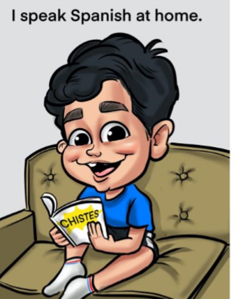
Values 2 Languages

Slide 33
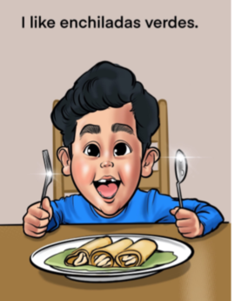
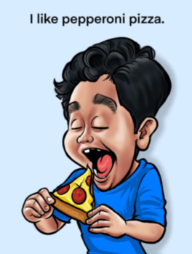
Values 2 Cultures

Slide 34
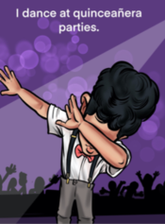
Values 2 Cultures

Slide 35
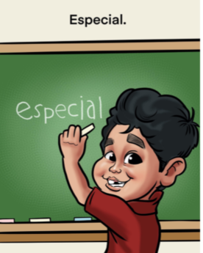
Juan Jose is ESPECIAL

Slide 36
MAT!!
Juan Jose is at a quinceañera party. He dances for _____ minutes and then eats some enchiladas verdes.
Then he dances for _____ more minutes.
How long does Juan Jose dance in total?
Math for Hispanic ELs: A Teacher's Guide for the Classroom and Distance Learning

Slide 37
Ewing, J. (2017). Facilitating pre-service teachers to learn the Mathematical Practices and engage English language learners. The Journal of Multicultural Affairs, 2(1), 1-5.
NO MAT!!!

Slide 38
Reflection
What is your take-away from today?
Feel free to share in the Chat

Slide 39
Guide
Thank you for letting me be your GUIDE.
Good luck guiding your EBs with MAT.

Slide 40
Monstrous Opportunity!
Learn more about MAT
at
EwingLearning.com

